Slide 1
Introduction to scientific programing – Linux, python and R
Ass-Prof Sereina Herzog, PhD
Ass-Prof Iva Pritišanac, PhD
Ass-Prof Pedro Sanchez Murcia, PhD

Slide 2
Introduction to scientific programing – Linux, python and R
Introduction to R
Ass-Prof Sereina Herzog, PhD

Slide 3
Introduction to R - Aims
Project structure
Using R as an example
Introduction to R using RStudio
How to use R
Plotting with R
Using ggplot for typical plots
Using Rmarkdown for report
Advantage of avoiding “copy & paste”

Slide 4
Introduction to scientific programing – Linux, python and R
Introduction to Python
Ass-Prof Iva Pritišanac, PhD

Slide 5
Introduction to Python
Python
History, overview, versatility of use
Today (Monday)
Session I (9:30–11:30): Getting Started with Python and Jupyter Notebooks – Variables & Data types, I/O, Conditionals, Loops
Session II (12:30–15:00): Lists, Functions, Error Handling
Tomorrow (Tuesday)
Session I (9:00–11:30): File I/O, working with libraries
Session II (12:30–15:00): Data Analysis with Python

Slide 6
Introduction to scientific programing – Linux, python and R
Introduction to Linux
Ass-Prof Pedro Sanchez Murcia, PhD

Slide 7
Introduction to Linux and High Performance Computing (HPC)
Introduction to Linux environment, distributions, permissions
Command-line basics
Vi editor
Environment variables, .bashrc file
Scripts and running scientific jobs
Visualization of data with gnuplot
SLURM
MedBioNode

Slide 8
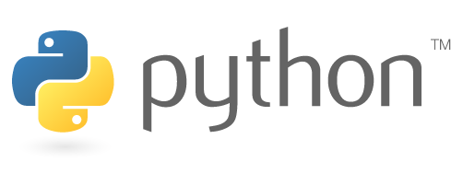

History and Versatility of Python
History of Python
Inventor: Guido van Rossum
Year Created: 1991
Purpose:
Designed to emphasize code readability
Make programming accessible to all skill levels
Inspired by ABC programming language
Focused on simplicity
Source https://gvanrossum.github.io/
Notes:
December 1989, Guido van Rossum – started as a “hobby” programming project – ultimately resulted in a Python interpreter & language
Wanted - an easy and intuitive language just as powerful as major competitors
Is open source -- anyone can contribute to development **
Code – should be “as understandable as plain English”
In 2019, Python second most popular language on GitHub
In 2024 Python the most used language on GitHub

Slide 9
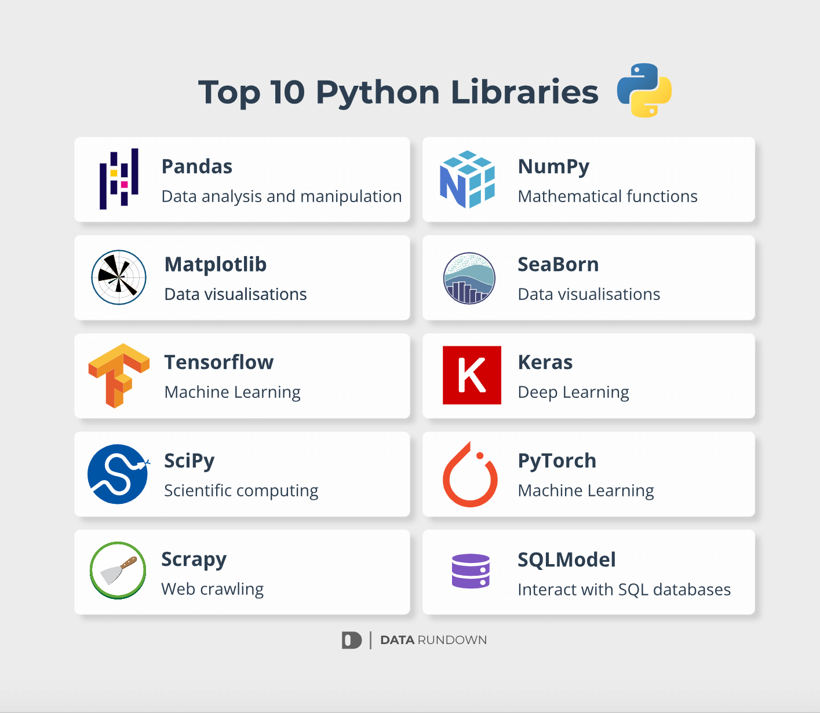
History and Versatility of Python
Why Python?
Open-source and versatile
Widely used across industries:
web development, data analysis, AI, …
An extensive collection of libraries
https://docs.python.org/3/library/
Source https://datarundown.com/python-top10-libraries/
Notes:
Why Python?
Open-source and versatile
Widely used across industries: web development, data analysis, AI
Supports a massive ecosystem of libraries and frameworks

Slide 10
Versatility of Python
Python in AI and Machine Learning
Machine Learning:
Libraries: scikit-learn, TensorFlow & PyTorch
Simple syntax - rapid prototyping
Artificial Intelligence:
Natural language processing, image recognition
Used in tools like ChatGPT, autonomous vehicles,
& predictive analytics
Source https://datarundown.com/python-top10-libraries/
Notes:
Scikit-learn, TensorFlow & PyTorch - power advanced ML models
Why Python?
Simplifies handling of complex AI workflows
Great readability and community support
Python -- utilized in the training and development of ChatGPT
ChatGPT Training and Python:
Training the Model:
TensorFlow and PyTorch were used to develop the deep learning models underlying ChatGPT
These frameworks handle GPU/TPU operations required for training on large datasets.
Data Processing:
Python's rdata manipulation libraries (pandas, NumPy, regex) - used to preprocess the massive amounts of textual data required for model training
Model Optimization:
Python-based tools and frameworks for distributed computing - training of ChatGPT on supercomputers, managing multiple GPUs/TPUs simultaneously
Serving ChatGPT:
Python-based libraries and frameworks like FastAPI or Flask - used to serve the model for inference, handling user requests and generating responses
Python's combination of simplicity, extensive libraries, and community support makes it the go-to language for developing large-scale machine learning projects like ChatGPT. Would you like me to integrate this information into your presentation?

Slide 11
Day 1: Introduction to Python
When use Python?
Data analysis, scripting, machine learning, …
General-purpose programming language
interpreted
slower than compiled languages
Notes:
use of Jupyter Notebooks
Demo - run a basic cell

Slide 12
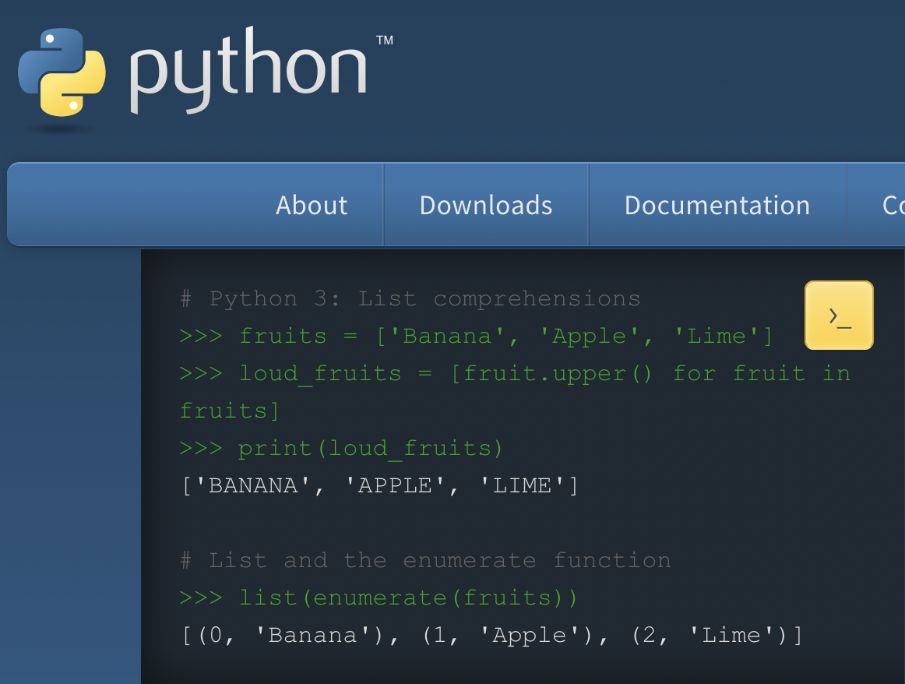
Day 1: Introduction to Python
When use Python?
Data analysis, scripting, machine learning, …
General-purpose programming language
interpreted
slower than compiled languages
Source https://www.python.org/
Notes:
Code as understandable as plain English
Suitability for everyday tasks (but also BIG PROJECTS!)

Slide 13
Interpreted vs Compiled Languages
# Python: Interpreted
- Code executed line-by-line by an interpreter (i.e. python)
- Intermediate bytecode generated (e.g., .pyc files)
- Highly flexible, easier to debug
# C: Compiled
- Code compiled into machine code before execution
- Faster execution but requires a compilation step

Slide 14
Interpreted vs Compiled Languages
# Python: Interpreted
- Code executed line-by-line by an interpreter (i.e. Python)
- Intermediate bytecode generated (e.g., .pyc files)
- Highly flexible, easier to debug
# C: Compiled
- Code compiled into machine code before execution
- Faster execution but requires a compilation step
# Example: Python # Example: C
print(”Hello, World!") # Compiled code would look like this before execution:
int main() {
printf("Hello, World!");
return 0;
}

Slide 15
Jupyter Notebooks
Why use Jupyter Notebooks?
Interactive coding environment
Combine code, text, and visuals
Demo: Hello World!
Using Binder
Linked to GitHub repository
Notes:
Binder - a free service, run by GitHub
- run Jupyter Notebooks “in the cloud”, directly from a GitHub repository
- no need to install anything locally—the notebooks available in a browser

Slide 16
Jupyter Notebooks
1. Running Your First Python Cell
Task:
Modify the "Hello, World!" message to include your name
Example:
print("Hello, [Your Name]!")
Python | iva.pritisanac@medunigraz.at

Slide 17
Jupyter Notebooks
1. Running Your First Python Cell
Task:
Modify the "Hello, World!" message to include your name
Example:
print("Hello, [Your Name]!")
Challenge:Write a program that prints a motivational quote or a fun fact in addition to "Hello, World!"

Slide 18
Python Basics
Data Types: Integers, Floats, Strings, Booleans
Variable Assignment:
x = 10
y = 3.14
name = "Python"
is_learning = True
= used to assign a variable; is different from ==, !=
Dynamic typing, reassignment, case sensitivity, naming rules
Notes:
A variable - reference to a value stored in memory
Variables - store and manipulate data during the execution of a program
Variables can hold different types of data, such as numbers, strings, lists, and more
Features of Python variables
Dynamic typing:
No need to explicitly declare the type of a variable (unlike C, C++)
The variable type -- inferred based on the value assigned
x = 10 # Integer
y = "Hello" # String
z = 3.14 # Float
Reassignment:
Variables can be reassigned to a new value, even of a different type
x = 10 # Initially an integer
x = "Text" # Now a string
Case Sensitivity:
Variable names are case-sensitive
name = "Alice"
Name = "Bob"
print(name) # Outputs: Alice
print(Name) # Outputs: Bob

Slide 19
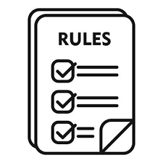
Python Basics
Dynamic typing, reassignment, case sensitivity, naming rules
Variable Naming Rules:
Must start with a letter (a-z, A-Z) or an underscore (_)
Cannot start with a number
Can only contain letters, numbers, and underscores
Cannot be a reserved Python keyword (e.g., if, else, for)
Notes:
Some common data types and how to assign values to variables
For more info, see Intro_Python_Course_PythonBasics.pptx

Slide 20
Variables and Data Types
Task:
Create variables for:
your age
favorite number
your hobby.
Print these variables using a single print() statement (with f-strings!)
Notes:
Example solution:
e.g.
age = 25
favorite_number = 7
hobby = "reading"
print(f"I am {age} years old, my favorite number is {favorite_number}, and I enjoy {hobby}.")

Slide 21

Variables and Data Types
Task:
Create variables for:
your age
favorite number
your hobby.
Print these variables using a single print() statement (with f-strings!)
Challenge: Swap the values of two variables without using a third variable

Slide 22
I/O
Simple I/O
Task:
Write a program that asks the user for their:
birth year
calculates their age
and prints a message:
“You are {user_age} years old!”
Notes:
Example solution:
birth_year = int(input("Enter your birth year: "))
age = 2025 – int(birth_year)
print(f"You are {age} years old.")

Slide 23
I/O
Task:
Write a program that asks the user for their:
birth year
calculates their age
and prints a message:
“You are {user_age} years old!”
Challenge: Ask the user for their first and last name, then print their initials
Notes:
For more info, see Intro_Python_Course_PythonBasics.pptx

Slide 24
Control Structures
Conditionals:
if x > 5:
print("x is large")
else:
print("x is small")
elif
Loops:
for i in range(5):
print(i)
While loop
Notes:
Use of conditionals and loops
For & While loop differences
For more info, see Intro_Python_Course_PythonBasics.pptx

Slide 25
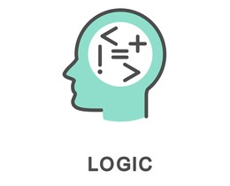
Control Structures AND Logic
Conditionals:
If, else, elif
Logic:
or, and
For, while loops
Control of flow: break, continue, pass
Notes:
For more info, see Intro_Python_Course_PythonBasics.pptx

Slide 26
Control Structures and Logic
Task:
Modify the "Even or Odd" program to check if a number is positive, negative, or zero
Notes:
Example solution:
number = int(input("Enter a number: "))
if number > 0:
print(”positive number")
elif number < 0:
print(”negative number")
else:
print(”zero")

Slide 27
Control Structures and Logic
Task:
Modify the "Even or Odd" program to check if a number is positive, negative, or zero
Challenge:Write a program that checks if a number is divisible by both 3 and 5!

Slide 28
Python Indentation Rules and Variable Scope
What is Indentation?
indentation defines code blocks (e.g., in loops, conditionals, and functions).
No braces {} like in C – indentation mandatory
Key Rules:
Use consistent spacing (4 spaces, i.e. 1 tab)
Indentation levels define the hierarchy of code
Python | iva.pritisanac@medunigraz.at

Slide 29
Python Indentation Rules
What is Indentation?
Key Rules:
Use consistent spacing (4 spaces, i.e. 1 tab)
Indentation levels define the hierarchy of code
if x > 0:
print("Positive number")
if x > 10:
print("Large number")
Error Handling: Inconsistent indentation – raises an error (IndentationError)

Slide 30
Download the notebook(s)
1. Open the notebook:
In the Binder environment, open the notebook
Download the Notebook:
Go to the menu bar and select: File → Download as → Notebook (.ipynb)
(.ipynb) saved to local machine
Optional: Export to other formats:
If prefered save in a different format (e.g., .html, .pdf, .py), under:
File → Download as
2. Re-upload later
To resume work later:
Open Binder again (or directly in Juptyer: https://jupyter.org/try-jupyter/tree/) “Upload” - in top right
Use the Upload button in the Jupyter Notebook file browser (top-right corner).
Select the previously downloaded .ipynb file to re-upload it to the Binder environment
Notes:
How to store changes made to ipython notebooks made in “Binder” or “JuptyerLab”
Changes not stored automatically in Binder
Explicitly “Download” your latest version of the notebook (.ipynb) file
Upload to Binder environment, or JuptyerLab environment

Slide 31
Variable Scope in Python
Global Scope:
Variables declared outside any function or block
Accessible anywhere in the program
x = 10 # Global variable
def print_global():
print(x)
print_global() # Output: 10
Notes:
How could we make this “x” a local variable?

Slide 32
Variable Scope in Python
Local Scope:
Variables declared inside a function (or block)
Only accessible within that function (code block)
def local_example():
y = 5 # Local variable
print(y)
local_example() # Output: 5
# print(y) # Raises NameError: y is not defined

Slide 33
Variable Scope in Python
Local Scope:
Variables declared inside a function (or block)
Only accessible within that function (code block)
Global Keyword
Use global to modify a global variable inside a function
z = 20
def modify_global():
global z
z = 30
modify_global()
print(z) # Output: ?

Slide 34
Variable Scope in Python
Local Scope:
Variables declared inside a function (or block)
Only accessible within that function (code block)
Global Keyword
Use global to modify a global variable inside a function
z = 20
def modify_global():
global z
z = 30
modify_global()
print(z) # Output: 30

Slide 35
Break

Slide 36
Introduction to Python
Python
History, overview, versatility of use
Today (Monday)
Session I (9:30–11:30): Getting Started with Python and Jupyter Notebooks – Variables & Data types, I/O, Conditionals, Loops
Session II (12:30–15:00): Lists, Functions, Error Handling
Tomorrow (Tuesday)
Session I (9:00–11:30): File I/O, working with libraries
Session II (12:30–15:00): Data Analysis with Python

Slide 37
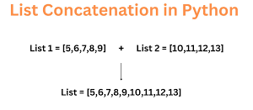
Working with Lists
Create and modify lists:
numbers = [1, 2, 3]
numbers.append(4)
print(numbers)
Other operations:e.g. extend, remove, sort
Looping through lists:
for num in numbers:
print(num)
With indexing:
for i in range(len(numbers)):
print(i, numbers[i])
This works?!
Notes:
Lists - dynamic collections
Basic list operations : append, extend, pop, remove value, sort, sort (reverse=True)
For more info on lists, see Intro_Python_Course_PythonBasics.pptx

Slide 38
Working with Lists
Task:
Create a list of 5 numbers, then:
Append a new number to the list
Remove the first number from the list
Print the updated list
Notes:
For more info on lists, see Intro_Python_Course_PythonBasics.pptx

Slide 39
Working with Lists
Task:
Create a list of 5 numbers, then:
Append a new number to the list
Remove the first number from the list
Print the updated list
Challenge:
Write a program that finds and prints the largest number in the list without using the max() function

Slide 40
Writing Functions
Defining Functions:
def greet(name):
return f"Hello, {name}!"
print(greet("Anna"))
Notes:
Functions - reusable blocks of code
Def
Parameters, default parameters
Return statement

Slide 41
Writing Functions
Modified Task 1: Add a default value to function definition
Modified Task 2: Create a function that does simple math (i.e. adds or multiplies two integer parameters)
Notes:
Example solution:
def greet(name="Student"):
return f"Hello, {name}!"
print(greet()) # Uses the default value
print(greet("Bob")) # Uses the provided value

Slide 42
Writing Functions
Modified Task 1: Add a default value to function definition
Modified Task 2: Create a function that does simple math (i.e. adds or multiplies two integer parameters)
Challenge Task 1: Extend the function to include a time-based greeting (Hint : add ‘time of day’ as another parameter)
Notes:
Example solution:
def greet(name="Student"):
return f"Hello, {name}!"
print(greet()) # Uses the default value
print(greet("Bob")) # Uses the provided value
def greet_with_time(name="Student", time_of_day="morning"):
return f"Good {time_of_day}, {name}!"
print(greet_with_time("Anna", "afternoon"))
print(greet_with_time())

Slide 43
Error Handling
Task: Modify the example program to repeatedly ask for valid input until the user enters an integer
Notes:
Example solution:
while True:
try:
number = int(input("Enter an integer: "))
print(f"You entered: {number}")
#break # uncomment to escape infinite while loop
except ValueError:
print("That's not a valid integer. Try again.")

Slide 44
Error Handling
Task: Modify the example program to repeatedly ask for valid input until the user enters an integer
Challenge:Write a program that asks the user for two numbers and divides them. Handle division by zero using a “try-except” block
Python | iva.pritisanac@medunigraz.at
Notes:
Example solution:
while True:
try:
number = int(input("Enter an integer: "))
print(f"You entered: {number}")
break
except ValueError:
print("That's not a valid integer. Try again.")

